Slide 1

How to apply Enterprise library in Application
News team – Kaibo Hao

Slide 2
Topic
What is Enterprise library(EL)
Change the way to implement application
Decouple your Application with Unity injection
Unity injection Demo
Adding Logic by Unity interception
Unity interception Demo
Review
Q & A
Notes:
Introducing how to use the Untiy Dependency Injection and Unity PolicyInjection to refractor an application.

Slide 3
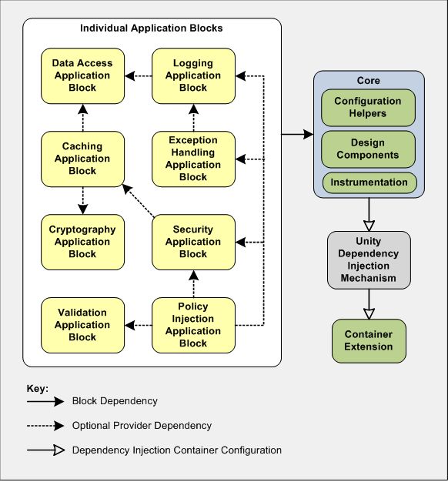

What is Enterprise library
A collection of reusable application blocks and infrastructure which provides highly configurable features to manage crosscutting concerns.
Enterprise Library 5.0
Released: Apr 20 2010
Dev status: Stable
Open source policy: Ms-PL

Slide 4
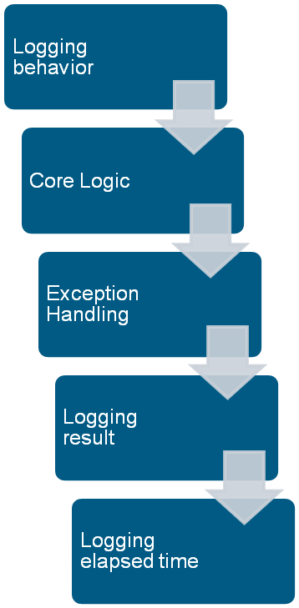
Change the way to implement application
Streamlined mode
public class MyClass
{
  public static void DoSomething(object arg)
  {
    // 1. Logging invoking method
    // 2. Core logic...
    // 3. Handing the possible exception
    // 4. Logging the invoking result
    // 5. Logging the elapsed time
  }
}

Slide 5
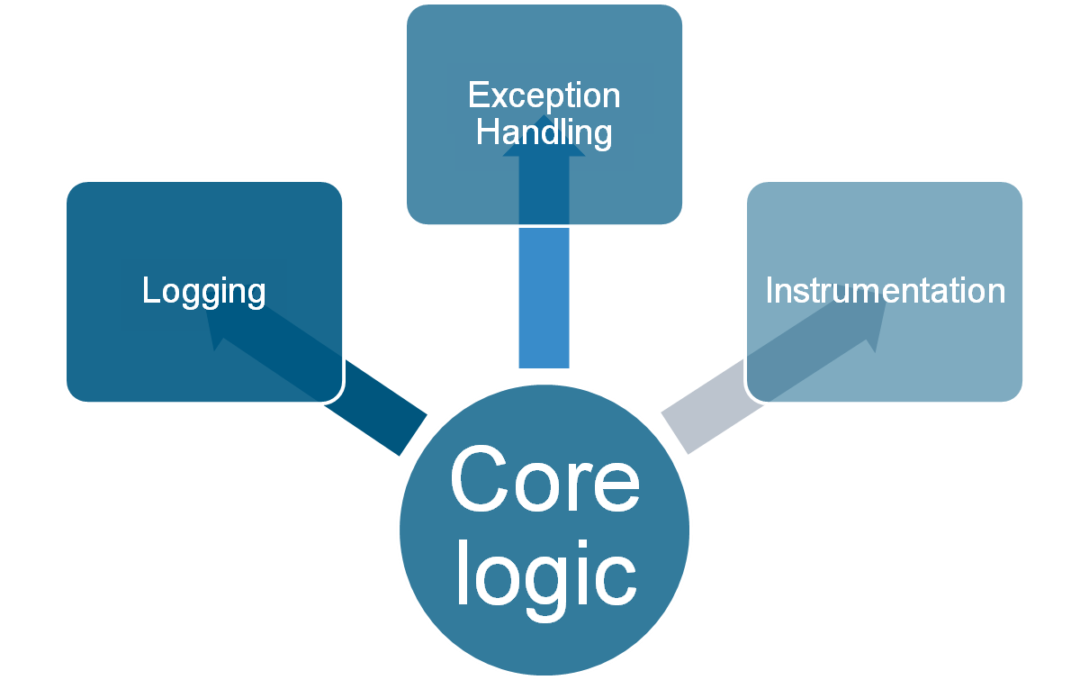
Change the way to implement application
Notes:
Declare the relationship between different components.

Slide 6
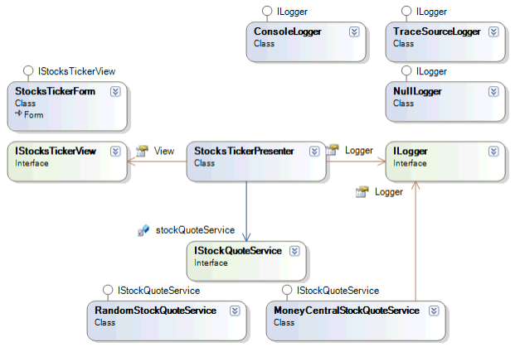
Change the way to implement application

Slide 7
Change the way to implement application
See Demo.

Slide 8
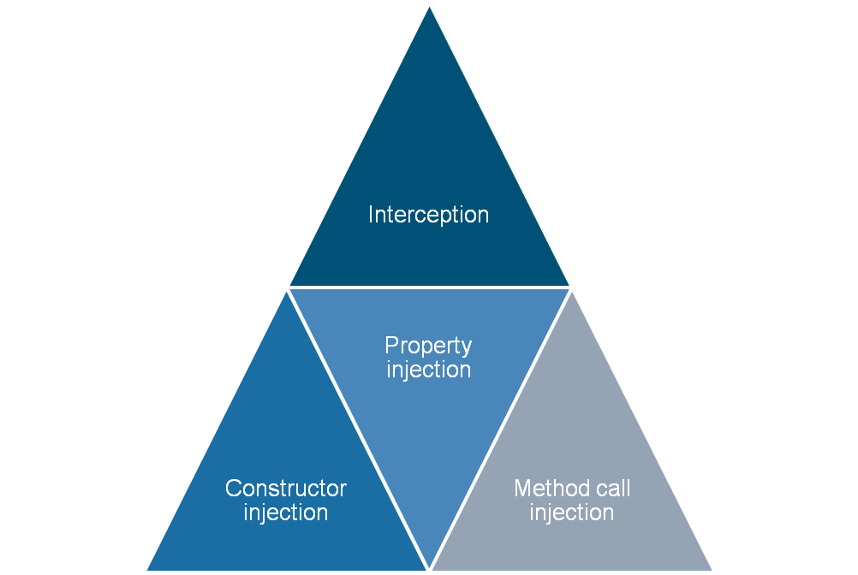
Decouple your application with Unity Injection
Unity is a lightweight, extensible dependency injection container.

Slide 9
Decouple your application with Unity Injection
Refactor it.
See Demo.

Slide 10
Change the way to implement application
Compare
 | Traditional sequence implementation | Dependency injection mode implementation
Cohesion | Cohesive | Loose coupled
Maintenance | Hard | Easy
Reuse | Hard | Easy
Deal with Changes | Hard | Easy
Object lifetime control | Hard | Easy

Slide 11
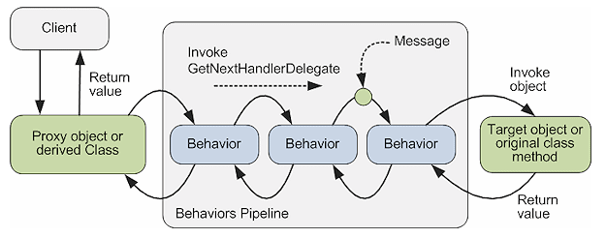
What is Unity interception
Unity interception enables you to effectively capture calls to objects and add additional functionality to the target object.

Slide 12
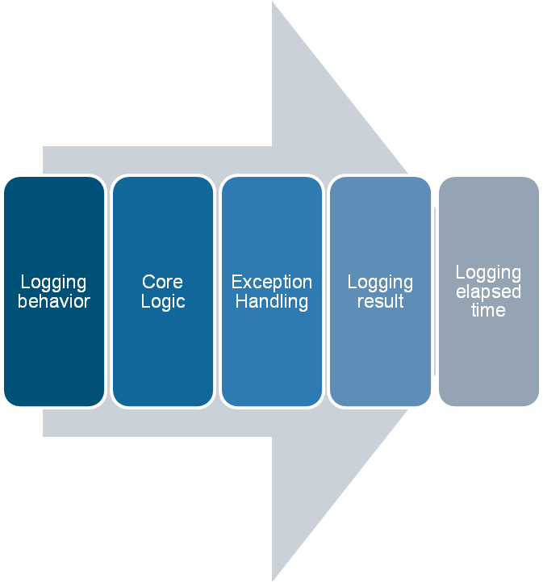
What is Unity interception
AOP mode
Implement strategy
Separate logic into different interfaces for different concerns
Core logic interface
Logging interface
Exception Handling interface
2. Make use of Unity to compose the logic with Unity Dependency Injection and Interception

Slide 13
How to use the EL to build your application
Continue refactor it.
See Demo.

Slide 14
What is Unity interception
Compare of interception techniques
Type | Description | Use
Transparent Proxy Interceptor | An instance interceptor. The proxy is created by using the .NET TransparentProxy/RealProxy infrastructure. | When the type to intercept is a MarshalByRefObject or when only methods from the type's implemented interfaces need to be intercepted.
Interface Interceptor | An instance interceptor. It can proxy only one interface on the object. It uses dynamic code generation to create the proxy class. | When resolving an interface mapped to a type.
Virtual Method Interceptor | A type interceptor. It uses dynamic code generation to create a derived class that is instantiated instead of the original intercepted class, and to hook up the behaviors. | When only virtual methods need to be intercepted.

Slide 15
What is Unity interception
Comparison of interception techniques
Type | Advantages | Disadvantages
Transparent Proxy Interceptor | Can intercept all methods of the target object (virtual, non-virtual, or interface). | The object must either implement an interface or inherit from System.MarshalByRefObject. If the marshal by reference object is not a base class, you can only proxy interface methods. The Transparent Proxy process is much slower than a regular method call.
Interface Interceptor | Allows interception on any object that implements the target interface. It is much faster than the TransparentProxyInterceptor. | It only intercepts methods on a single interface. It cannot cast a proxy back to the target object's class or to other interfaces on the target object.
Virtual Method Interceptor | Calls are much faster than the Transparent Proxy Interceptor. | Interception only happens on virtual methods. You must set up interception at object creation time and cannot intercept an existing object.

Slide 16
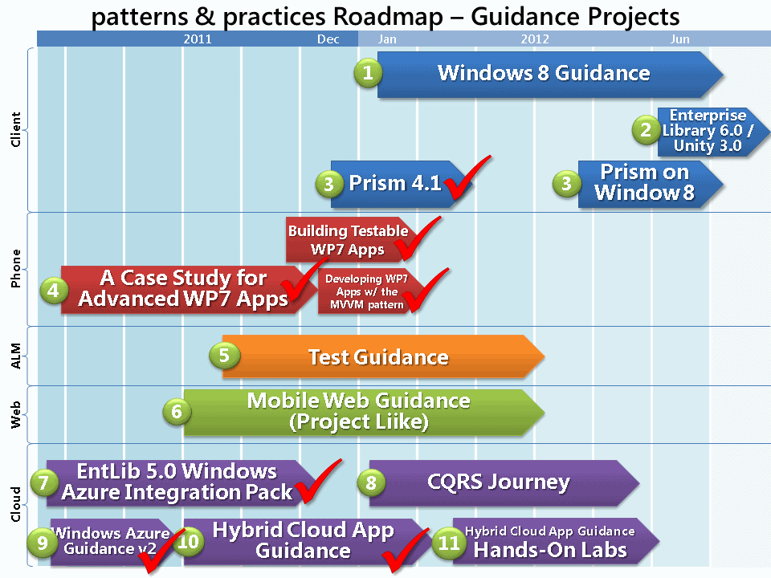
Next

Slide 17
Q&A

